Slide 1

Delayed Differential Equations
Harrison Coons, Steven Doolan, Sam Throne

Slide 2
Overview of the Model
3 cores
Bi-Directional transferring of packets
Uniform delay in:
Transferring
Communication
Varying Processing Power and Queue Size
Core 1
Core 2
Core 3
Notes:
Keep it brief
Delays have their own slide
Processing Power and Queue Size are mentioned later
-Steven

Slide 3

The Differential Equation
$$\frac{dq_{i}}{dt}=I_{i}+\sum_{h=1,h≠i}^{3}{T_{hi}}−\sum_{h=1,h≠i}^{3}{T_{ih}}−\left(P_{i}−k_{T}\sum_{h=1,h ≠i}^{3}{T_{ih}}\right)$$
Notes:
---------Harrison
Explain the different parts
$q_{i}$ - queue of node i
$I_{i}$ - inflow to node i
$P_{i}$ - processing power of i
$T_{mn}$ - transfer from node m to node n
$k_{T}$ - cost of transferring data
$k_{r}$ - queue redistribution limit
The first Equation is the differential
The second Equation is the pipes used for the delays

Slide 4

Delays
Communication Delay
Transferring Delay
Standard delay of Half a Holder
Packets in limbo go through pipes
Full Holder Delay
$$\frac{dq_{h}}{dt}=\sum_{i=1}^{3}{T_{ih}(t−τ)}−\sum_{i=1}^{3}{T_{hi}(t)}$$
Notes:
---Sam
Delay for Transferring is on receiving, the data leaves immediately
Focus on Transferring delay
Talk about Communication Delay more in Queue Management`

Slide 5
Features
Processing Power weakens when communicating
Varying per Core
Processing Power
Queue Size
Varying for the System
Histories (fabricated data)
Delays
Queue Minimum
Input function
Notes:
--Steven
The cores or processors divide their capability, and set aside a small amount of computing power to send out packets when the size of the queue is grater than the minimum side.

Slide 6
Queue Management
Queue calculate how to divide excess packets by:
Space available
Processing power
Updates the equations via a matrix
Reduces the matrix to net changes
Notes:
--Steven
Explain the diagram
Blue represents the packets in term
Gray is the empty space in the queue
Bottom segment is the reserve amount
Talk about Queue Overflow prevention

Slide 7

Queue Manipulation
$$T_{mn}=d\frac{q_{m}\left(t−τ\right)−k_{r}s_{m}}{\sum_{j=1}^{3}{w_{j}}}w_{j}$$
$$w_{j}=\frac{\left(s_{j}−q_{j}\left(t−τ\right)\right)P_{j}}{\sum_{k=1,k≠j}^{3}{\left(s_{k}−q_{k}\left(t−τ\right)\right)P_{k}} −\left(s_{j}−q_{j}\left(t\right)\right)P_{j}}$$
Notes:
--Steven
$q_{i}$ - queue of node i
$I_{i}$ - inflow to node i
$P_{i}$ - processing power of i
$T_{mn}$ - transfer from node m to node n
$k_{T}$ - cost of transferring data
$k_{r}$ - queue redistribution limit

Slide 8
Default Settings
Queue
Queue Transfers
Notes:
Harrison

Slide 9
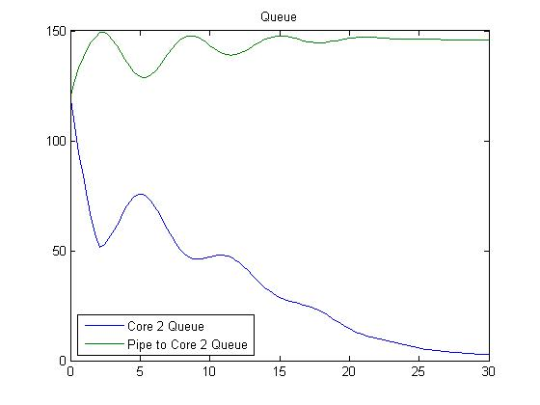
Send/Receive Delay
Notes:
Harrison

Slide 10
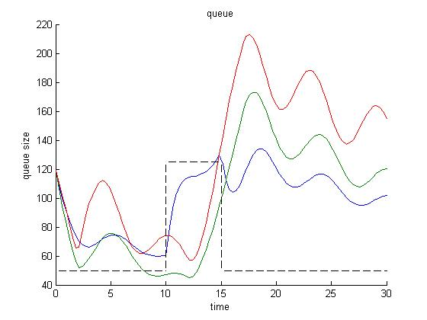
Decision Making Delay
Notes:
Harrison

Slide 11
Sinusoidal input
Sinusoidal history
Default
Notes:
--Sam
As opposed to constant input and history

Slide 12
Queue Size Change Small
Queue Size Change Big
Default
Floor increasing
Notes:
--Sam
Floor increasing –up by factor of 10
Was 1%
Increasing 10%

Slide 13
Less Variation in Processing Power
More Variation in Processing Power
Default
Notes:
-Sam
Less PP
Blue = 15
Red =20
Green =25
Default
Blue =10
Red =20
Green =30
More
Blue =5
Red =20
Green =35

